Slide 1

Python Basics Workshop
Joshua Waters

Slide 2

Setting up your environment
The university uses IDLE but is unnecessarily annoying to work with
Much better: Visual Studio Code
Intellisense
Search and replace
Debugging
Real time error/warnings
Looks nicer!
Can also use PyCharm IDE, but is perhaps too complex for now
https://code.visualstudio.com/download
Notes:
So first we’re going to setup your coding environment. The uni uses IDLE and it comes default with Python if you download it via the website, but it’s annoying and lacks far too many incredibly powerful features that most other tools have, to really be worth using
The best coding solution for Python, in my opinion, is Visual Studio Code, NOT to be mixed up with Visual Studio. This is a code editor, but has one-click extension support meaning that you get very powerful tools with no fuss.
These tools include:
Intellisense – it predicts what you are typing and brings up suggestions
Advanced search and find and replace functionality
Debugging tools
Warning and error handling in real time, not just when you run your program
It looks nicer! You can customize your theme just how you like it :)
Pycharm IDE by JetBrains is another good tool you could use but I suggest that for now it is too complex for you, but I do invite you to explore it in your own time
I’ll put the download link in chat as well
Download the one for your OS
Go through the process, make sure everyone is up to date before moving on

Slide 3
Using VSC
A good idea is to open your folder in the editor so that your files are easy to manage
You can also split your files in multiple windows
Use Ctrl+K + Z to active Zen mode, very nice for no distractions coding
The most useful key binds to use, by FAR, are:
Ctrl + S -> Save
Ctrl + C -> Copy
Ctrl + X -> Cut
Ctrl + V -> Paste
Notes:
A good idea is to open your folder in the editor so that your files are easy to manage
Go through process

Slide 4
Let’s make a BMI calculator
What does it need to work?
User to input height and mass
Check against average ranges
What data structures do we need for this?
Loop
If condition
Input/Output
Variables (data storage)
Notes:
So, let’s actually write a program that does stuff
What do we need for the program?
The user needs to input their height and mass
The program needs calculate their BMI from this
Then it needs to check if you are underweight, average, or overweight
What sort of stuff will we need to make this work?
We need a loop for every time they want to input a new set of values (because why not)
If conditions to check bounds
Printing and inputting data
Storing data in variables

Slide 5
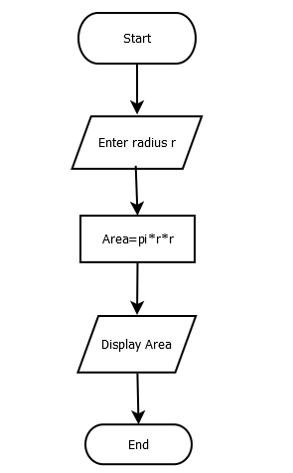
It’s always a good idea to plan your code
Pseudocode is good, although for such a simple program it’s not so useful
Flowcharts are the next best path to go down
### Circle area calculator
Get radius from user
Square radius
Multiply result by pi
Print resulting area
Notes:
Plan your code if you are stuck on what you’re meant to do. Sometimes you don’t need to, and that’s ok (unless your course requires it haha)
If you’re planning for complex algorithms, pseudocode can help you out greatly – this is basically plain text written out to explain in very general terms what the code does
But generally flowcharts are fantastic at visually showing what your overall program, or sub systems within the program does

Slide 6
Make a variable table
Useful when you might have lots of data to store
Variable Name | Variable Type | Example Value
loop | Boolean | True
bmis_taken | Integer | 3
bmis_total | Float | 25.65
bmi_average | Float | 11.13
height | Float | 1.75
mass | Float | 60
bmi | Float | 19.59
Notes:
Be mindful – do you need to cast your data between string and int/float?
How accurate do you want your value to be?

Slide 7
A “quick” word on “good practice”
There’s a few things you should be mindful of when you code:
Commenting
Naming scheme
Whitespace
Scope
Indentation
Notes:
Let’s go through some good practice points “quickly” (this is actually super important so I’ll cover it a fair bit)
There’s a few things you should be mindful of when you code to keep good consistency between files, projects and developers
Comment your code
Indent properly
Follow, then stick by, the same variable and function naming scheme for every file in a project
Control your whitespace use
Variable/function scope

Slide 8
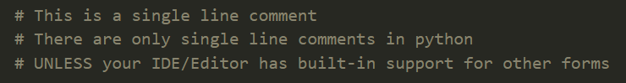
Comments
A way of leaving yourself messages in the code
They should be relevant and concise
You can also use them to comment out certain lines when testing/debugging your code
Notes:
Comments provide a way to leave yourself and others messages in your code
They should be relevant and concise so that you and others can go back and understand what the code does
You can use comments to quickly disable/enable lines of code when testing/debugging your code (like print statements)
A nice key bind you can use for this in VS Code is Ctrl + /

Slide 9
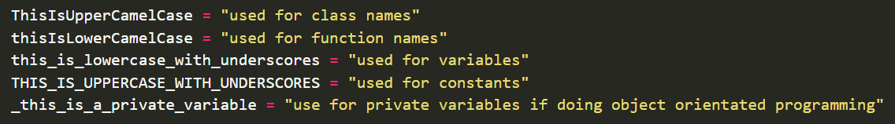
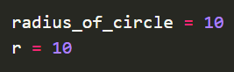
Naming Schemes
Every language has its own naming scheme, and even then it’s down to personal preference
Python’s goes like the following:
Keep variable names concise
Which is better?
Notes:
Every language has its own naming scheme, and even then it’s down to personal preference
Python’s naming scheme is like shown in this image – I like this and you should try and stick to it
Keep your variable names short and concise! Any longer than 10 characters and it’s getting long (it may be best to be long though)
Which is better here? Within context of the program, you could probably tell that ‘r’ is the radius, so you don’t need to say the whole thing

Slide 10
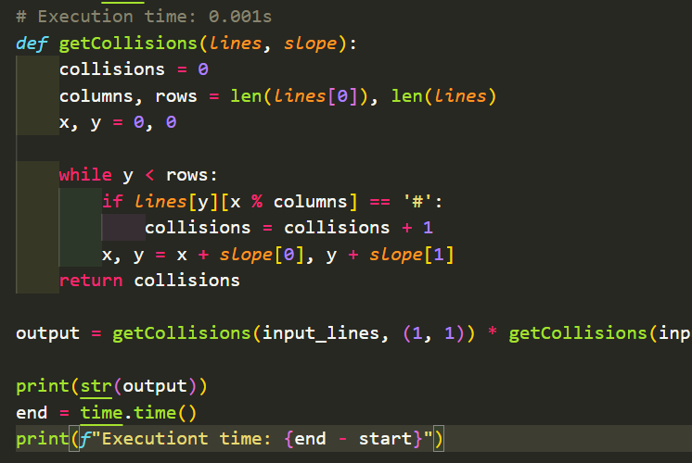
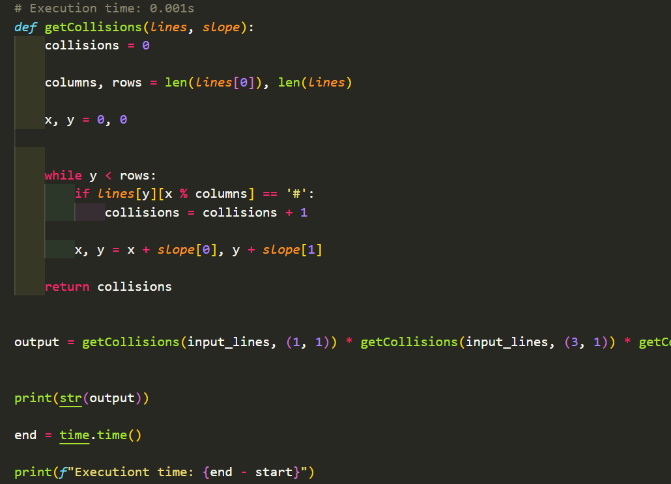
W h i t e s p a c e
W h i c h i s b e t t e r ?
Notes:
- It’s perfectly fine to have a bunch of whitespace between your lines if you’re the only one reading your program, but please, if someone else is trying to read, understand, or fix your program, please don’t put a line between every line and 5 lines between every section

Slide 11
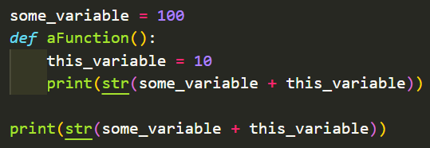
Scope
Scope is the area of a program where an object (e.g. variable) that has a certain name, can be identified
For example, which print statement won’t work?
Notes:
Scope is the area of a program where an object (e.g. variable) that has a certain name, can be identified
If you declare a variable inside a function, that variable is only accessible inside that function
If you declare a variable outside a function, that variable can be accessible inside a function (within its own container)
For example, which print statement won’t work?
The bottom one, because “this_variable” is outside of the scope of the function it was declared inside
Scope does get a lot more complex than this when you have name overloading, classes, functions in functions, etc. But you don’t need to worry about that quite yet

Slide 12
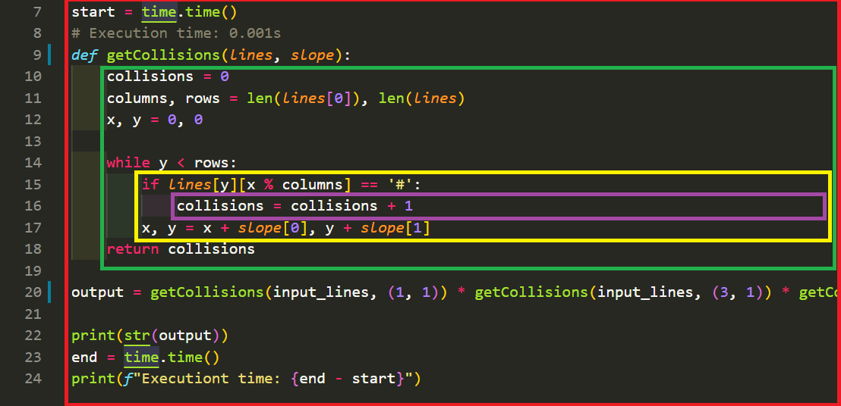
Indentation
Use the tab key to indent code inwards
Defines code containers
Notes:
Use the tab key to indent code inwards (although VSC will likely do this for you because it’s smart)
In Python, indentation is absolutely required for the program to work
In most other languages, indentation is purely aesthetical and is not required for program functionality HOWEVER you should always still do it properly

Slide 13
Anyway… user input
Let’s say we want height to be in meters and mass to be in kg
Assigns inputted value to this height variable
Input function
Converts the input to a float as all inputs are strings
Outputs this message before taking the user input
Notes:
Anyway… let’s get back to the program; user input
Let’s say we want height to be in meters and mass to be in kg
Now we do the same with mass
What would we replace if we wanted height to be an integer?

Slide 14
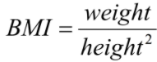
Calculating BMI
This bit is the easiest…
BMI is simply calculated by doing
In Python, you can use / for divide and ** for power
Remember to assign your result to a new variable
Notes:
Now to calculate BMI
This bit is super easy
All we need to do, is follow this formula
In Python, you use slash for divide and two asterisk for “to the power of”
Remember to assign your result to a new variable, in this case being our bmi

Slide 15
Outputting data
Print the calculated BMI
Why wouldn’t this work?
We need to convert this float, bmi, to a string, fit for printing
This would work, however, the output could have many decimal places
Use the round function to well… round it
Notes:
Now we want to print the BMI we just calculated
Why wouldn’t this line work?
We need to convert this float variable bmi to a string, so that it will actually print
This would work, however the output could be something like 20.475696969420
So we can use the in-built round() function to round it to round it
The second parameter of the function is the number of decimal places we want to round the number to

Slide 16
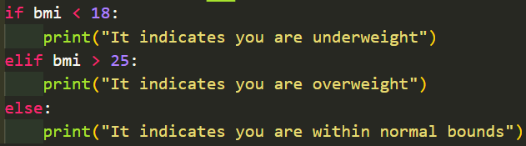
Checking between ranges
A quick search gives us the ranges we need
We use an if statement chain for this…
If bmi is less than 18 then…
Else if bmi is more than 25 then…
Else then…
Notes:
We need to check between the ranges
A quick google search tells us below 18 is underweight and above 25 is overweight
We can use an if else change for this
Else if is elif in python
Remember the colon at the end of each condition!
Do you know what you would do if you wanted to specifically check if the BMI is between 18 and 25 in the same condition?

Slide 17
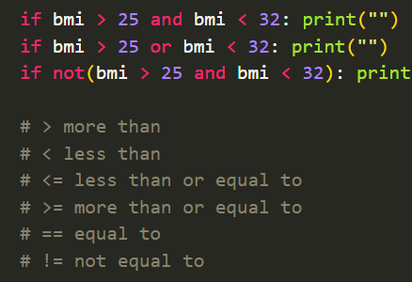
Operators
There are a number of operators for conditions in Python
You can see a full list on w3schools
Notes:
There are loads of operators or varying types:
Arithmetic like plus, minus, divide, modulus etc
Assignment like equals, plus equals etc
Comparison like those in the comments in this image
Logical like those in the if conditions in this image
Identity for comparing objects, like is and is not
Bitwise to compare binary numbers
Full list on https://www.w3schools.com/python/python_operators.asp

Slide 18
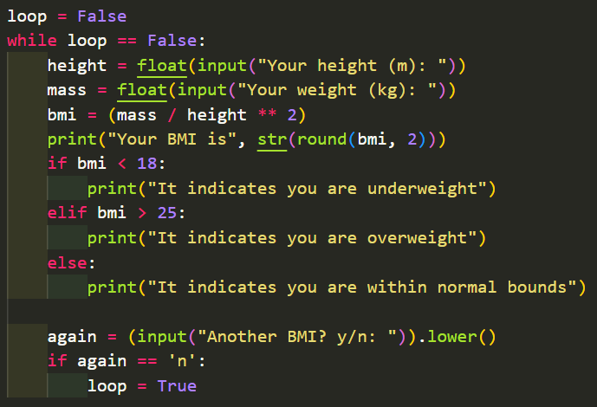
What about taking multiple readings?
We use a while loop
Every time the program outputs the BMI, ask the user if they want to do it again
If the user says yes, loop the program again
If the user says no, stop the loop
Make sure your indentation inside the loop is correct!
We need that bottom check to be inside the while loop
Notes:
What if we want to take multiple readings?
We can use a while loop!
This will keep the program going round and round until we tell it to stop
Make sure the bottom check is inside the loop otherwise it will loop infinitely!
The .lower() function at the end of the input there turns the input into all lowercase
This is a form of input validation
E.g. if the user inputted “N” instead of “n”, the program would turn the “N” into “n” and then the check would be true

Slide 19
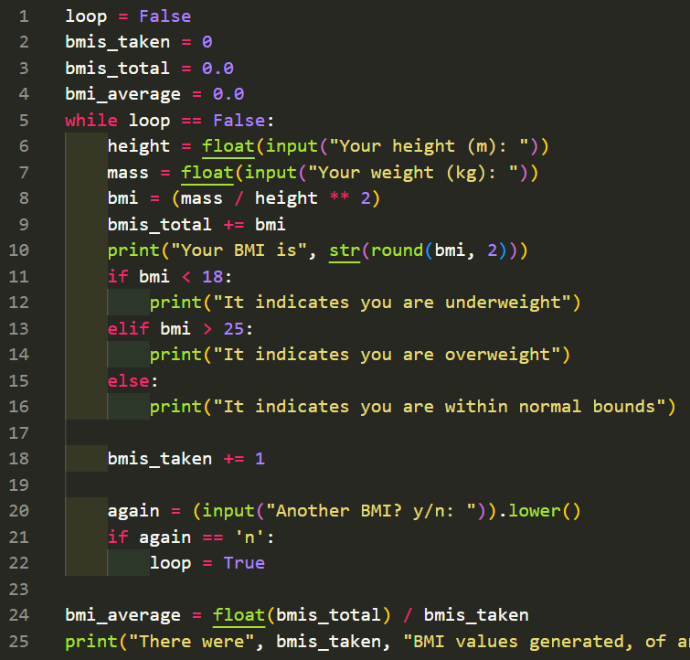
Now let’s give the loop a purpose…
Let’s say we want to calculate the average BMI of all of them taken
We need to sum the total BMI and the number taken
Then we just print the average out at the end
Notes:
Now let’s give the loop a purpose
Let’s say we want to calculate the average BMI of all of the BMIs taken
We need to sum the BMIs for a total, and the number of BMIs taken
Then we just print the average out at the end

Slide 20
Testing tables!
Testing your program will become important later for your projects
For this, you can make testing tables
Test | Expected Output | Actual Output
Height 1.69 Mass 55.42 | “Your BMI is 19.4” “It indicates you are within normal bounds” | “Your BMI is 19.4” “It indicates you are within normal bounds”
Height 1.69 Mass 55.42 x2 | inputting blah “There were 2 BMI values generated, of an average of 19.42” | inputting blah “There were 2 BMI values generated, of an average of 19.42”
Height 0 Mass 1000 | “You can’t have a height of 0!”
Height -10 Mass -49.3 | “You can’t have a negative height!” | “Your BMI is -0.49” “It indicates you are underweight”
Height * Mass t | “Invalid height, input again: “
Notes:
Testing tables are important for discovering where you need to implement more input sanitation, finding bugs or other unintended behaviour
I use the traffic light system to determine success, failure, or unintended behaviour – you would obviously have a key but not enough space on the slide
Note in row 2, you would write all the reproduction steps and outputs but I only have limited space on this slide
So you can see that this program needs a lot more input sanitation to be safe from naughty users!

Slide 21
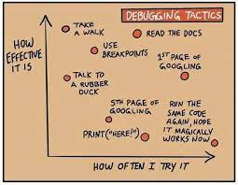
Debugging your dodgy programs™
Program isn’t working as intended, so put a breakpoint on it!
Notes:
Debugging tools is by far the best reason why I suggest to use VS Code over IDLE
Other reasons include search and replace, intellisense, better error handling, etc.
Let’s say your program isn’t working as intended, or there is an annoying bug you can’t quite get to the root of
Put a breakpoint on a line around the area you think that’s the root of the problem
Show how to put a breakpoint on a line, show stepping through the program, etc.

Slide 22
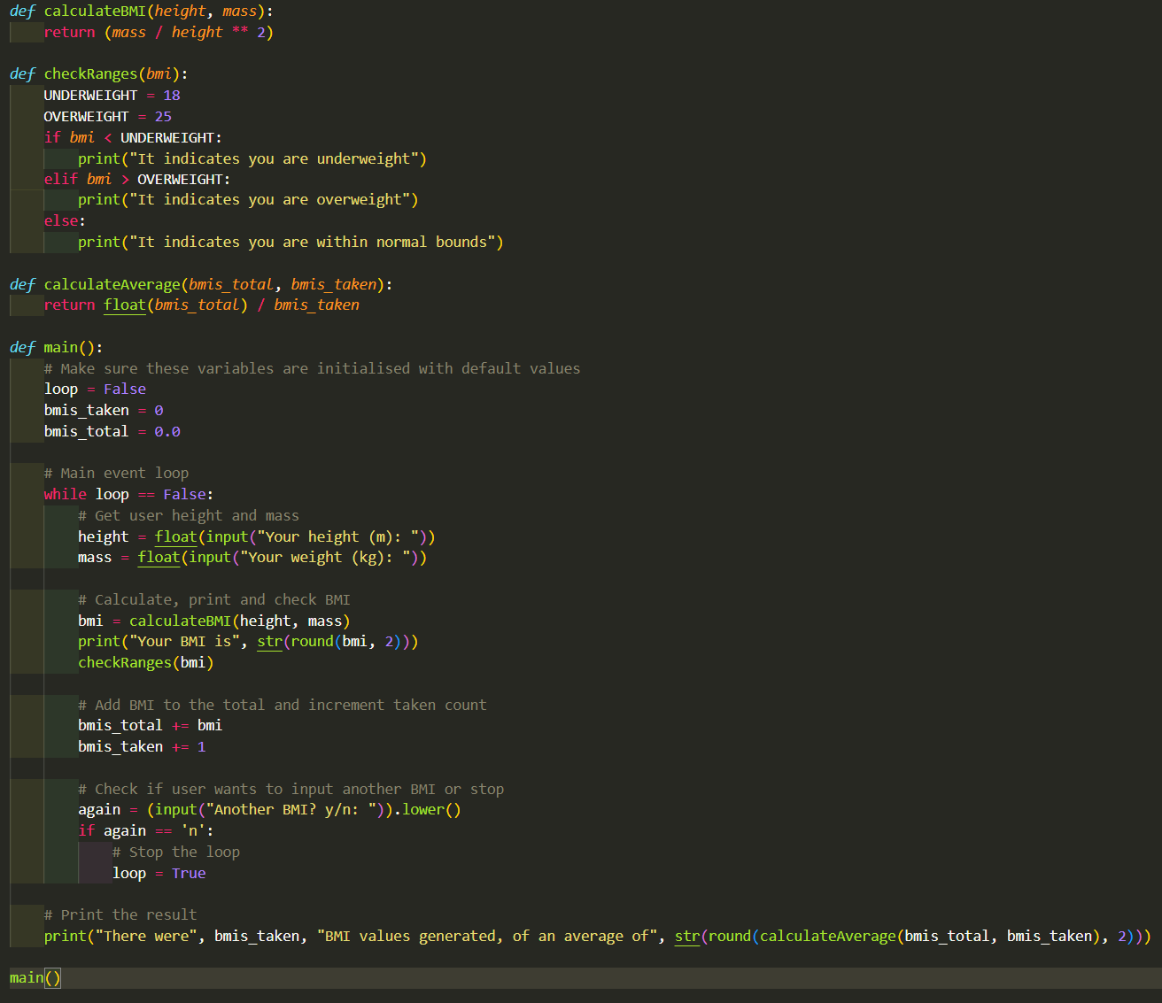
Functions
Each function has its own dedicated job
There can be multiple variables in the program with the same name due to scope
Notice the order of functions
Notes:
Let’s put the program into split up functions now
Each function has its own dedicated job
There can be multiple variables in the program with the same name due to scope e.g. bmi can be used in checkRanges and main functions because neither can access the other’s code
Functions can be put inside other functions, both when calling and creating e.g. calculateAverage is being called inside that round, then convert to string, then inside the print functions
Notice the order of functions – if main was at the top, it wouldn’t run, as the program wouldn’t have built the other function it needs yet so be careful about this

Slide 23
Thanks for paying attention
Please post any questions in chat
Feel free to ask any questions in the #first-year or #support channels

